Slide 1
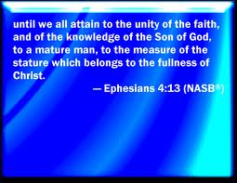
What is true freedom? How does man find independence?

Slide 2
What about SDA “independent ministries”
A few years ago, faithful SDA members in Iowa, Illinois and Indiana called for a symposium of “independent ministries,” “Hope International, Prophecy Countdown, Light Bearer, and Watchman, what of the night”, as well as others were invited to discuss their mission, messages and goals. They wanted (in the face of the increasing Adventist apostasy) to gain some direction, cohesion, and unity for the advancement of present truth in our time.
I’m sure that the several hundred believers represented from those three states thought this symposium very important because everyone who professes to love the cause of God will certainly want to be where earnest plans are being laid for its advancement. Of all those invited, however, only William Grothier, of “Watchman, what of the night”, deigned to attend.

Slide 3
What spirit is behind this independence?
As the symposium went forward it gradually became public knowledge that the various leaders and administrators of these “independent ministries’ would not come unless their expenses were totally paid, or be assured of many faithful tithe-paying converts- or they just couldn’t be bothered to respond to the invitation.

Slide 4

What is true freedom?
Freedom implies many things, doesn’t it ?
Peace, truth, love, balance, wisdom
Freedom from manipulation, freedom from fear
Freedom from want

Slide 5
Is this kind of independence, good?
In fact, for all of the brethren who have spent any time in or around “independent ministries,” the saying “power corrupts and absolute power corrupts absolutely” is a very timely saying. The power of the leader of the “ministry” is quite often near absolute. Because of having no system of checks and balances in a church structure or organization, (such as committees, treasurers, and delegates in session), the one man, or small body of men, and their hand-picked inner circle can exploit whoever they want, pretty much, however they want.

Slide 6
What kind of freedom is this?
Very often, sincerely converted believers in the Advent message had sold all they possessed just to have enough money to get to the “independent ministry” and to start their own work at the ministry. Those who put themselves in this situation would, sadly, add to the possibility of exploitation. Once the leaders had someone living on site at the “ministry,” the poor souls couldn’t afford to move anywhere else since they weren’t being paid for their labour at the “ministry.”

Slide 7
What kind of freedom is mentioned here?
“The days are fast approaching when there will be great perplexity and confusion. Satan, clothed in angel robes, will deceive, if possible, the very elect. There will be gods many and lords many. Every wind of doctrine will be blowing…. Satan will sorely harass the faithful; but, in the name of Jesus, they will come off more than conquerors.” 5 T 80-82 Men think they are representing the justice of God, but they do not represent His tenderness and the great love wherewith He has loved us. Their human invention originating with the specious devices of Satan, appears fair enough to the blinded eyes of men, because it is inherent in their nature. A lie, believed, practiced, becomes a truth to them. Thus the purpose of the satanic agencies is accomplished, that men should reach these conclusions through the working of their own inventive minds. {TM 363.4}

Slide 8
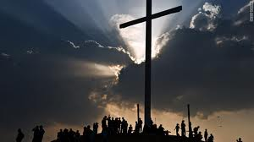
Can the cross set us free?

Slide 9
Deception is sad, but then, it is nothing new
These two testimonies clearly show our day in the light of Bible prophecy. You may ask, “What has happened to the church of God?” She, who started out so well founded on the law of God, the Testimony of Jesus and the joyful expectation of Christ’s soon coming- how did she ever get into the present state of confusion?
The church seems to have lost its freedom and become dependent upon the world. Witness the vast governmental support for the Adventist institutions like their hospitals, clinics and schools. Also, witness the dependence upon the civil arm of the government to enforce her decrees through lawsuits. This causes us to scratch our heads in wonder and disbelief. Where do we go from here? How can this sad state be reversed and the church be reformed? We will pose another question here: Has any church every been reformed from within?

Slide 10
The basis of freedom- truth.
We, the original movement for Reform from within the SDA church, were born out of the compromise of the sixth commandment that SDA leaders made in time of war. They chose to define the church as a material thing only, (church buildings, hospitals, publishing houses, etc.) and thus sought favour from the world by urging the members into war after the threat was made that these material things would be taken away by the government if they did not comply. If the church is only material, then the institutions and buildings must be preserved at any cost. Those members who stood faithful to the message, refusing military service, were forcibly disfellowshiped from the only church they knew and loved. The reason for their disfellowshipment, as given by the church, was what they called, “unchristian conduct.”

Slide 11
What sort of freedom is this?
The original message of the SDA church against politics and war is clearly outlined in the Testimonies. “We have enlisted in the army of the Lord, and we are not to fight on the enemy's side, but on the side of Christ, where we can be a united whole, in sentiment, in action, in spirit, in fellowship. Those who are Christians indeed will be branches of the true vine, and will bear the same fruit as the vine. They will act in harmony, in Christian fellowship. They will not wear political badges, but the badge of Christ What are we to do, then?--Let political questions alone. . . Those teachers in the church or in the school who distinguish themselves by their zeal in politics, should be relieved of their work and responsibilities without delay; for the Lord will not co-operate with them.” GW 393

Slide 12
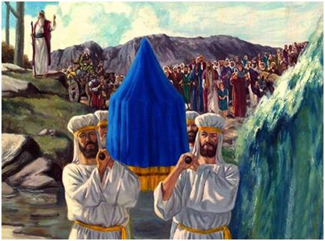
Jesus said the truth would set you free

Slide 13
Truth=balance
“The tithe should not be used to pay any one for speechifying on political questions. Every teacher, minister, or leader in our ranks who is stirred with a desire to ventilate his opinions on political questions, should be converted by a belief in the truth, or give up his work…. It is a mistake for you to link your interests with any political party, to cast your vote with them or for them….God's children are to separate themselves from politics, from any alliance with unbelievers….Do not take part in political strife….Again and again Christ had been asked to decide legal and political questions; but He refused to interfere in temporal matters.” GW 393-396

Slide 14
What if they had a war, and no one came to it?
“I was shown that God's people, who are His peculiar treasure, cannot engage in this perplexing war, for it is opposed to every principle of their faith. In the army they cannot obey the truth and at the same time obey the requirements of their officers. There would be a continual violation of conscience. Worldly men are governed by worldly principles. They can appreciate no other. Worldly policy and public opinion comprise the principle of action that governs them and leads them to practice the form of right-doing. But God's people cannot be governed by these motives.

Slide 15
It took true courage to follow these truths
“The words and commands of God, written in the soul, are spirit and life, and there is power in them to bring into subjection and enforce obedience. The ten precepts of Jehovah are the foundation of all righteous and good laws. Those who love God's commandments will conform to every good law of the land. But if the requirements of the rulers are such as conflict with the laws of God, the only question to be settled is: Shall we obey God, or man?” {1T 361.2}

Slide 16
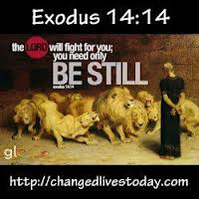
God, finally, is in control of everything

Slide 17
The darkness deepens
In World War II, the SDA leaders confirmed what they had begun in WW I. In the Second World War, they openly listed with the governments as eligible for military service. (Recent developments in Hungary show the SDA church will still disfellowship anyone who stands for the sixth commandment, whether in protesting the compromise of the church in participation in military service or protesting abortion in SDA hospitals. )

Slide 18
What kind of freedom are we talking about here?
But the SDA church, in Hungary and a number of other countries, has never bothered to apply for or receive such permission [for a religious exemption to military service]. The faults here does not lie with the suffering membership- who do not wish to bear arms, - but with a leadership who fear they might lose favor and “peace in their time” of being highly-placed Adventist church officials….

Slide 19
Is this freedom?
and Elder Wilson added: ‘I would like to emphasize that this [point of not bearing arms] is not a doctrine of our Church. We do not make this a doctrine: we cannot make it a doctrine not to bear arms. This is left up to the conscience of each young man [as to ] what position he will take in given situations.” Taken from Hungarian Crisis Update, Nov. 15, 1984, published by Pilgrim’s Rest, Beersheba Springs, Tn., 37305

Slide 20
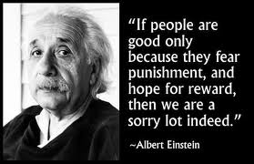
Losing the approval of God- to win the approval of man?

Slide 21
It takes faith to have courage
In World War II, brethren from the Reform Church suffered persecution at the hands of the governments and sometimes were even betrayed into those hands by their former brethren in the SDA church.
All this has been foretold by the Spirit of Prophecy. God’s Messenger saw a great Reformation and Revival going forward. This was to happen in conjunction with the great test of war. “….The time is nearing when the great crisis in the history of the world will have come, when every movement in the government of God will be watched with intense interest and inexpressible apprehension. In quick succession the judgments of God will follow one another--fire and flood and earthquake, with war and bloodshed. Oh, that the people might know the time of their visitation!” {9T 97.1}

Slide 22
All this has been prophesied
“AGAIN, IN THE YEAR 1904, THE PREDICTION WAS MADE, "Soon grievous troubles will arise among the nations, troubles that will not cease until Jesus comes. . . . The judgments of God are in the land. The wars and rumors of wars, the destruction by fire and flood, say clearly that the time of trouble, which is to increase until the end, is very near at hand. We have no time to lose. The world is stirred with the spirit of war." The time and the work, SDA pub. 1920

Slide 23
The calls became more and more strident
“ FIVE YEARS LATER, OR IN THE YEAR 1909, SHE SOLEMNLY CHARGED THE REPRESENTATIVES AT THE GENERAL CONFERENCE ASSEMBLY TO PREPARE THEIR HEARTS FOR THE TERRIBLE SCENES OF STRIFE AND OPPRESSION BEYOND ANYTHING THEY HAD CONCEIVED OF, SOON TO BE WITNESSED AMONG THE NATIONS OF THE EARTH. SHE SAID, ‘Very soon the strife and oppression of foreign nations will break forth with an intensity that you do not now anticipate.’ FIVE YEARS AFTER THIS PREDICTION WAS MADE, THE GREAT WORLD WAR WAS PRECIPITATED.” Ibid.

Slide 24
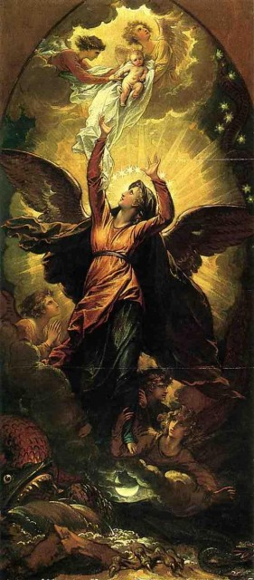
The true church has always had to suffer persecution

Slide 25
Missionary work is hard in time of war
“IN REFERRING TO THIS SAME TIME, WE WERE TOLD, "The passage from place to place to spread the truth will soon be hedged with dangers on the right hand and on the left. Everything will be placed to obstruct our way, so we shall not be able to do that which is possible now." THEN FOLLOWED THE ADMONITION, "We must look our work fairly in the face, and advance as fast as possible in aggressive warfare. . . . We have warnings now which we may give, a work now which we may do, but soon it will be more difficult than we can imagine." --"Special Testimonies to Ministers," p. 64. {PH120 12.2}

Slide 26

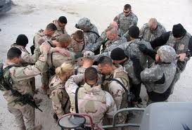
Missionary work is hard in time of war
For those who are being reached
For those who are witnessing

Slide 27
The warnings that worldly conformity has silenced
"The work which the church has failed to do in a time of peace and prosperity, she will have to do in a terrible crisis, under most discouraging, forbidding circumstances. The warnings that worldly conformity has silenced or withheld, must be given under the fiercest opposition from enemies of the faith. . . . The members of the church will individually be tested and proved. They will be placed in circumstances where they will be forced to bear witness for the truth."--"Testimonies for the Church," Vol. V, page 463.
"A trial is before the young which they have not anticipated. They are to be brought into most distressing perplexity. The genuineness of their faith is to be proved."--Id. Vol. I, page 269.

Slide 28
A prophecy of reformation
“WHILE THESE CALAMITIES WERE WITNESSED AMONG THE NATIONS OF THE EARTH, ANOTHER SCENE WAS PRESENTED--A GREAT REFORMATORY MOVEMENT AMONG GOD'S PEOPLE. SHE SAID, "I have been deeply impressed by the scenes that have recently passed before me in the night season. There seemed to be a great movement--a work of revival--going forward in many places. Our people were moving into line, responding to God's call. God calls upon those who are willing to be controlled by the Holy Spirit to lead out in a work of thorough reformation. I see a crisis before us, and the Lord calls for his laborers to come into line. Every soul should now stand in a position of deeper, truer consecration to God than during the years that have passed. Do not the Scriptures call for a more pure and holy work than we have yet seen?"--"General Conference Bulletin," May 19, 1913.

Slide 29
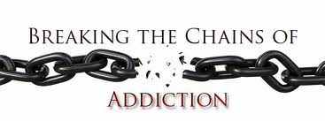
There are more addictions than to drugs

Slide 30
Addiction to error? Pride? Fear?
“No line of truth that has made the Seventh-day Adventist people what they are, is to be weakened. We have the old landmarks of truth, experience, and duty, and we are to stand firmly in defense of our principles, in full view of the world.--Testimonies, Vol. 6, p. 17. God's people will not endure the test unless there is a revival and a reformation. Vol. 7, 285 Unless there is a decided reformation among the people of God, He will turn His face from them. {8T 146.1}

Slide 31
Revival and Reformation- related.
“A revival and a reformation must take place under the ministration of the Holy Spirit. Revival and reformation are two different things. Revival signifies a renewal of spiritual life, a quickening of the powers of mind and heart, a resurrection from the spiritual death. Reformation signifies a reorganization, a change in ideas and theories, habits and practices. Reformation will not bring forth the good fruit of righteousness unless it is connected with the revival of the Spirit. Revival and reformation are to do their appointed work, and in doing this work they must blend.-- Review and Herald, Feb. 25, 1902. {ChS 42.2}

Slide 32
How do independents relate to revival and reformation?
With this historical and doctrinal backdrop in place, let’s proceed to the “independent ministry” position towards the SDA Reform Movement in general. We are criticized severely by the independent ministries for calling the SDA church, Babylon. First, let’s define the term, “church” from Inspiration and then we can have a better idea as to who is Babylon and who is not.

Slide 33

At first, the pathway of error is very close to the path of truth

Slide 34
His church is precious in His sight
“The church is God's fortress, His city of refuge, which He holds in a revolted world. Any betrayal of the church is treachery to Him who has bought mankind with the blood of His only-begotten Son. From the beginning, faithful souls have constituted the church on earth. In every age the Lord has had His watchmen, who have borne a faithful testimony to the generation in which they lived. These sentinels gave the message of warning; and when they were called to lay off their armor, others took up the work. God brought these witnesses into covenant relation with Himself, uniting the church on earth with the church in heaven. He has sent forth His angels to minister to His church, and the gates of hell have not been able to prevail against His people. {AA 11.2}

Slide 35
The Church has One Foundation
“Through centuries of persecution, conflict, and darkness, God has sustained His church. Not one cloud has fallen upon it that He has not prepared for; not one opposing force has risen to counterwork His work, that He has not foreseen. All has taken place as He predicted. He has not left His church forsaken, but has traced in prophetic declarations what would occur, and that which His Spirit inspired the prophets to foretell has been brought about. All His purposes will be fulfilled. His law is linked with His throne, and no power of evil can destroy it. Truth is inspired and guarded by God; and it will triumph over all opposition. {AA 11.3}

Slide 36
Pure doctrines of heaven
“ During ages of spiritual darkness the church of God has been as a city set on a hill. From age to age, through successive generations, the pure doctrines of heaven have been unfolding within its borders. Enfeebled and defective as it may appear, the church is the one object upon which God bestows in a special sense His supreme regard. It is the theater of His grace, in which He delights to reveal His power to transform hearts. {AA 12.1}

Slide 37
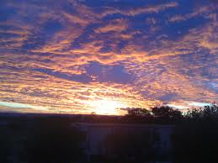
Is His church limited to something material?

Slide 38
The true church, unlike anything in the world
"Whereunto," asked Christ, "shall we liken the kingdom of God? or with what comparison shall we compare it?" Mark 4:30. He could not employ the kingdoms of the world as a similitude. In society He found nothing with which to compare it. Earthly kingdoms rule by the ascendancy of physical power; but from Christ's kingdom every carnal weapon, every instrument of coercion, is banished. This kingdom is to uplift and ennoble humanity. God's church is the court of holy life, filled with varied gifts and endowed with the Holy Spirit. The members are to find their happiness in the happiness of those whom they help and bless.” AA 12.2

Slide 39
God has faithful souls everywhere but the visible church is the apple of His eye
The faithful souls in Christ have always constituted the church of God on Earth. Clearly, they are faithful to the law of God and the Testimony of Jesus. “And the dragon was wroth with the woman, and went to make war with the remnant of her seed, which keep the commandments of God, and have the testimony of Jesus Christ. “ Rev. 12:17

Slide 40
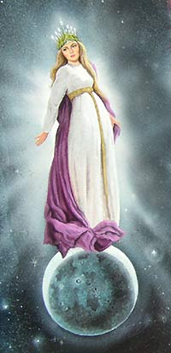
Who is Satan especially angry with?

Slide 41
Another prophecy of Reformation
“In the time of the end every divine institution is to be restored. The breach made in the law at the time the Sabbath was changed by man, is to be repaired. God's remnant people, standing before the world as reformers, are to show that the law of God is the foundation of all enduring reform and that the Sabbath of the fourth commandment is to stand as a memorial of creation, a constant reminder of the power of God.
In clear, distinct lines they are to present the necessity of obedience to all the precepts of the Decalogue. Constrained by the love of Christ, they are to co-operate with Him in building up the waste places. They are to be repairers of the breach, restorers of paths to dwell in. See verse 12. {PK 678.2}

Slide 42
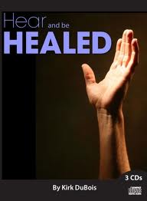
Every divine institution will be restored

Slide 43
The Church vs. Babylon
Now, who constitutes Babylon? “Babylon is said to be "the mother of harlots." By her daughters must be symbolized churches that cling to her doctrines and traditions, and follow her example of sacrifice the truth and the approval of God, in order to form an unlawful alliance with the world. The message of Revelation 14, announcing the fall of Babylon must apply to religious bodies that were once pure and have become corrupt. Since this message follows the warning of the judgment, it must be given in the last days; therefore it cannot refer to the Roman Church alone, for that church has been in a fallen condition for many centuries.

Slide 44
The church cannot be Babylon
. In the words of the prophet to Israel: ‘Thy renown went forth among the heathen for thy beauty: for it was perfect through My comeliness, which I had put upon thee, saith the Lord God." But they fell by the same desire which was the curse and ruin of Israel--the desire of imitating the practices and courting the friendship of the ungodly. ‘Thou didst trust in thine own beauty, and playedst the harlot because of thy renown.’ Ezekiel 16:14, 15. {GC 382.3}

Slide 45
More Prophecies of Reformation
Furthermore, in the eighteenth chapter of the Revelation the people of God are called upon to come out of Babylon. According to this scripture, many of God's people must still be in Babylon. And in what religious bodies are the greater part of the followers of Christ now to be found? Without doubt, in the various churches professing the Protestant faith. At the time of their rise these churches took a noble stand for God and the truth, and His blessing was with them. Even the unbelieving world was constrained to acknowledge the beneficent results that followed an acceptance of the principles of the gospel

Slide 46
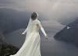
We always have a choice: trust in self, or God?
Our resources are always pretty limited, but when we learn to trust in God, that can make all the difference.

Slide 47
Can we lean upon the arm of the civil government?
“Many of the Protestant churches are following Rome's example of iniquitous connection with "the kings of the earth"--the state churches, by their relation to secular governments; and other denominations, by seeking the favor of the world. And the term "Babylon"--confusion--may be appropriately applied to these bodies, all professing to derive their doctrines from the Bible, yet divided into almost innumerable sects, with widely conflicting creeds and theories. {GC 383.1}

Slide 48
Is this true freedom?
So, those who once were pure but have become corrupt through connection with the kings of the Earth constitute Babylon. Is this unlawful connection with the kings of the Earth not exactly what happened with the SDA leadership in time of war? Ever since, that connection with the kings of the Earth has been strengthening,which may explain some of the incredible apostasy in the SDA church today.

Slide 49

This is called spiritual adultery in the Bible

Slide 50
Truth=Freedom
How do the “independent ministries” relate to this apostasy in the church? “Oh, we’re not involved with it,” they say. Some, like Ron Spear, (head of Hope International) have had to go so far as to hide their membership somewhere in a small-out of the way SDA church- from the SDA General Conference and Union leadership in order to maintain their “good standing with the SDA church.” While maintaining his membership and supporting the church with his presence, tithe, and influence, Ron Spear will roundly criticize the apostasy in SDA teaching and practice.
Kind of confusing, wouldn’t you say?

Slide 51
Even if the truth separates us from the nearest relative- it’s still truth
The remnant church cannot be Babylon, however, for they are upholding the commandments of God. Any betrayal of the true church, the one that is upholding the commandments of God, is treachery, remember.
“We are just as accountable for evils that we might have checked in others, by reproof, by warning, by exercise of parental or pastoral authority, as if we were guilty of the acts ourselves. {4T 516.3}
“Eli should have first attempted to restrain evil by mild measures; but if that would not avail, he should have subdued the wrong by the sternest measures. God's honor must be sacredly preserved, even if it separates us from the nearest relative.” Ibid. 4T 516.4

Slide 52
Should we be reminded of our sins?
“Those who seek to cloak sin, and make it appear less aggravated to the mind of the offender, are doing the work of the false prophets, and may expect the retributive wrath of God to follow such a course. The Lord will never accommodate his ways to the wishes of corrupt men. The false prophet condemned Jeremiah for afflicting the people with his severe denunciations; and he sought to reassure them by promising them prosperity, thinking that the poor people should not be continually reminded of their sins and threatened with punishment. This course strengthened the people to resist the true prophet's counsel, and intensified their enmity toward him. {GW92 87.1}

Slide 53
God may have mercy, for those who confess and repent, but no sympathy, if they continue to do evil
“God has no sympathy with the evil-doer. He gives no one liberty to gloss over the sins of his people, nor to cry, “Peace! peace!” when he has declared that there shall be no peace for the wicked. Those who stir up rebellion against the servants whom God sends to deliver his messages, are rebelling against the word of the Lord.— Vol. 4, p. 185.
The Spirit of God has clearly foretold the sorry state of affairs in which we find ourselves today.

Slide 54

What is the sealing message?

Slide 55
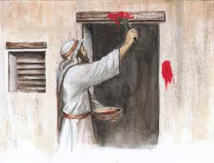
This was the cross back then- what is it now?

Slide 56
Can we trust religious leaders and their organization, just because they say so?
“And in that day seven women shall take hold of one man, saying, We will eat our own bread, and wear our own apparel: only let us be called by thy name, to take away our reproach.” Isaiah 4:1
Yes, there are many who want to be named with the “world-wide organizational entity of Adventism” and have their own approval associated with that name and yet have their own doctrine (bread) and their own character (apparel), but this is spiritual duplicity.

Slide 57
They were not starting a new organization
Here, I would like to speak to a situation that happened at a “Steps to Life” camp meeting in the 1990s. Elder Ralph Larson ordained six men to the ministry within the SDA church. These men were: Terry Ross, ron Reeves, Dr. John Grosboll, Mike Thompson, Elder Bob Trefz, and Elder John Osborne. Here is a quote from Elder Ralph Larson’s sermon at the ordination service, which we read from “Present Truth Sentinel,” put out by “The Printed Page, P.O. Box 1888, Troy, MT., 59935. “They were not starting a new church or a new organization….

Slide 58
No separate church when one is necessary?
We are not starting a separate church. Wherever these men preach and teach, they will urge the people not to leave the SDA church, which we all devoutly believe is God’s true church in our time.” Jesus said, “To whom you yield yourselves servants to obey, His servants you are.”
We cannot support an apostate organization that is teaching and practicing known error and sin and yet still be the people of God. To support such an organization with either our presence, our influence or our tithe would be wrong. Actually, any one of these practices would be wrong according to the Spirit of Prophecy.

Slide 59
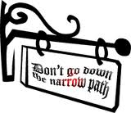
Is this the path of reformation? Or confusion?

Slide 60
Has there ever been such a thing as an infallible organization?
There is but one church in the world who are at the present time standing in the breach, and making up the hedge, building up the old waste places; and for any man to call the attention of the world and other churches to this church, denouncing her as Babylon, is to do a work in harmony with him who is the accuser of the brethren. Is it possible that men will arise from among us, who speak perverse things, and give voice to the very sentiments that Satan would have disseminated in the world in regard to those
who keep the commandments of God, and have the faith of Jesus? Is there not work enough to satisfy your zeal in presenting the truth to those who are in the darkness of error? As those who have been made stewards of means and ability, you have been misapplying your Lord's goods in disseminating error. The whole world is filled with hatred of those who proclaim the binding claims of the law of God, and the church who are loyal to Jehovah must engage in no ordinary conflict. TM 50,51

Slide 61
Different parties of SDA believers?
“The different parties of professed Advent believers have each a little truth, but God has given all these truths to His children who are being prepared for the day of God. He has also given them truths that none of these parties know, neither will they understand. Things which are sealed up to them, the Lord has opened to those who will see and are ready to understand. If God has any new light to communicate, He will let His chosen and beloved understand it, without their going to have their minds enlightened by hearing those who are in darkness and error. {EW 124.2}

Slide 62
The concept of separation
“I was shown the necessity of those who believe that we are having the last message of mercy, being separate from those who are daily imbibing new errors. I saw that neither young nor old should attend their meetings; for it is wrong to thus encourage them while they teach error that is a deadly poison to the soul and teach for doctrines the commandments of men. The influence of such gatherings is not good. If God has delivered us from such darkness and error, we should stand fast in the liberty wherewith He has set us free and rejoice in the truth.

Slide 63
Separation, (continued)
A key principle
Angels are watching over us.
God is displeased with us when we go to listen to error, without being obliged to go; for unless He sends us to those meetings where error is forced home to the people by the power of the will, He will not keep us.
The angels cease their watchful care over us, and we are left to the buffetings of the enemy, to be darkened and weakened by him and the power of his evil angels; and the light around us becomes contaminated with the darkness. {EW 124.3}

Slide 64
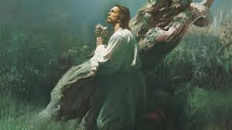
Jesus became one with us, that we could become one with Him.

Slide 65
What kind of freedom is this?
“I saw that we have no time to throw away in listening to fables. Our minds should not be thus diverted, but should be occupied with the present truth, and seeking wisdom that we may obtain a more thorough knowledge of our position, that with meekness we may be able to give a reason of our hope from the Scriptures. While false doctrines and dangerous errors are pressed upon the mind, it cannot be dwelling upon the truth which is to fit and prepare the house of Israel to stand in the day of the Lord.”

Slide 66
Freedom and independence, in truth
God has a remnant church today that appears “enfeebled and defective” to worldly sight but the “pure doctrines of heaven [are] unfolding within its borders.” God is “leading not stray offshoots, not one here and one there, but a people.” TM, 61
“Some have advanced the thought that, as we near the close of time, every child of God will act independently of any religious organization. But I have been instructed by the Lord that in this work there is no such thing as every man's being independent. The stars of heaven are all under law, each influencing the other to do the will of God, yielding their common obedience to the law that controls their action. And, in order that the Lord's work may advance healthfully and solidly, His people must draw together. {9T 258.1}

Slide 67
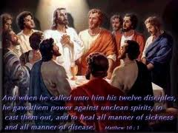
Think of the disciples
There were great contrasts amongst them- but still the Holy Spirit unified them

Slide 68
Sinful independence?
“The spasmodic, fitful movements of some who claim to be Christians are well represented by the work of strong but untrained horses. When one pulls forward, another pulls back, and at the voice of their master one plunges ahead and the other stands immovable. If men will not move in concert in the great and grand work for this time, there will be confusion. It is not a good sign when men refuse to unite with their brethren and prefer to act alone. Let laborers take into their confidence the brethren who are free to point out every departure from right principles. If men wear the yoke of Christ, they can not pull apart; they will draw with Christ. {9T 258.2}

Slide 69
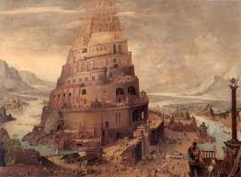
A monument to independence

Slide 70
Freedom?
“Some workers pull with all the power that God has given them, but they have not yet learned that they should not pull alone. Instead of isolating themselves let them draw in harmony with their fellow laborers. Unless they do this, their activity will work at the wrong time and in the wrong way. They will often work counter to that which God would have done, and thus their work is worse than wasted. {9T 258.3}

Slide 71
The place of organization in the work of God
“Oh, how Satan would rejoice to get in among this people and disorganize the work at a time when thorough organization is essential and will be the greatest power to keep out spurious uprisings and to refute claims not endorsed by the word of God! We want to hold the lines evenly, that there shall be no breaking down of the system of regulation and order. In this way license shall not be given to disorderly elements to control the work at this time. We are living in a time when order, system, and unity of action are most essential. And the truth must bind us together like strong cords in order that no distracted efforts may be witnessed among the workers. If disorderly manifestations appear, we must have clear discernment to distinguish the spurious from the genuine. Let no messages be proclaimed until they have borne a careful scrutiny in every jot and tittle. {TM 228.2}

Slide 72
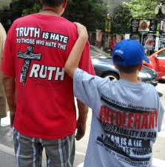
Truth is hate, to those who hate the truth

Slide 73
How can we come through every trial?
Yes, the most difficult thing for Moses to do was to choose to suffer affliction with the people of God rather than be called the son of Pharoah’s daughter. “Pharoah” has a daughter today. She is the apostate SDA organization and all of those who are influenced by this apostasy and take part in it. Rebellion may be in the “very air we breathe” as Inspiration tells us, but God will have a people that will come through every trial by holding on to His Word of truth.

Slide 74
The Visible Church
“We should all feel our individual responsibility as members of the visible church and workers in the vineyard of the Lord. We should not wait for our brethren, who are as frail as ourselves, to help us along; for our precious Saviour has invited us to join ourselves to Him and unite our weakness with His strength, our ignorance with His wisdom, our unworthiness with His merit. None of us can occupy a neutral position; our influence will tell for or against. We are active agents Christ or for the enemy. We either gather with Jesus or scatter abroad. True conversion is a radical change. The very drift of the mind and bent of the heart should be turned and life become new again in Christ. {4T 16.4}

Slide 75
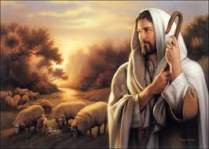
Jesus is still the peaceful Shepherd

Slide 76
Perfect Unity=Perfect Freedom
John 17:20-23
The High Priestly prayer
“God is leading out a people to stand in perfect unity upon the platform of eternal truth. Christ gave Himself to the world that He might "purify unto Himself a peculiar people, zealous of good works." This refining process is designed to purge the church from all unrighteousness and the spirit of discord and contention, that they may build up instead of tear down, and concentrate their energies on the great work before them.
God designs that His people should all come into the unity of the faith. The prayer of the Christ just prior to His crucifixion was that His disciples might be one, even as He was one with the Father, that the world might believe that the Father had sent Him. This most touching and wonderful prayer reaches down the ages, even to our day; for His words were: "Neither pray I for these alone, but for them also which shall believe on Me through their word." {4T 17.1}

Slide 77
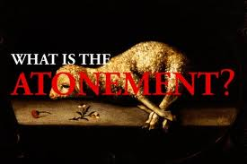
How do we stand in relation to the atonement?

Slide 78
John 17:20-23
“How earnestly should the professed followers of Christ seek to answer this prayer in their lives. Many do not realize the sacredness of church relationship and are loath to submit to restraint and discipline. Their course of action shows that they exalt their own judgment above that of the united church, and they are not careful to guard themselves lest they encourage a spirit of opposition to its voice. Those who hold responsible positions in the church may have faults in common with other people and may err in their decisions; but notwithstanding this, the church of Christ on earth has given to them an authority that cannot be lightly esteemed. Christ, after His resurrection, delegated power unto His church, saying: "Whosesoever sins ye remit, they are remitted unto them; and whosesoever sins ye retain, they are retained." {4T 17.2}

Slide 79
Members of the visible Church
“As members of the visible church, and workers in the vineyard of the Lord, all professed Christians should do their utmost to preserve peace, harmony, and love in the church. Mark the prayer of Christ: "That they all may be one; as Thou, Father, art in Me, and I in Thee, that they also may be one in Us: that the world may believe that Thou hast sent Me." The unity of the church is the convincing evidence that God has sent Jesus into the world as its Redeemer. This is an argument which worldlings cannot controvert. Therefore Satan is constantly working to prevent this union and harmony…..Satan is the great accuser of the brethren, and all who engage in this work are enlisted in his service. {5T 619.3}

Slide 80
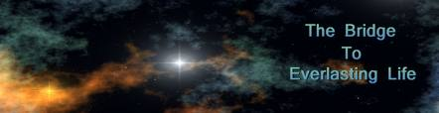
The bridge is still the same today

Slide 81
The proper place of organization
“We profess to have more truth than other denominations; yet if this does not lead to greater consecration, to purer, holier lives, of what benefit is it to us? It would be better for us never to have seen the light of truth than to profess to accept it and not be sanctified through it. 5 T 619.4
Organization has a very important part to play in our salvation. Humility, faith in God’s ability to lead a brother into truth, and submission to authority are essential things that we get from organization. Organization is not an end in itself, but he means whereby God’s message is to be brought forth with power to the world.

Slide 82
Independence or dependence upon Christ?
You considered it a virtue in you to persistently maintain your position of independence. You did not seem to have a true sense of the power that God has given to His church in the voice of the General Conference. You thought that in responding to the call made to you by the General Conference you were submitting to the judgment and mind of one man. You accordingly manifested an independence, a set, willful spirit, which was all wrong. {3T 492.2}

Slide 83
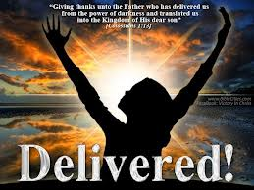
Dependence upon Christ, or independence?

Slide 84
The experience of one minister
“God gave you a precious experience at that time which was of value to you, and which has greatly increased your success as a minister of Christ. Your proud, unyielding will was subdued. You had a genuine conversion. This led to reflection and to your position upon leadership. Your principles in regard to leadership are right, but you do not make the right application of them. If you should let the power in the church, the voice and judgment of the General Conference, stand in the place you have given my husband, there could then be no fault found with your position. But you greatly err in giving to one man's mind and judgment that authority and influence which God has invested in His church in the judgment and voice of the General Conference. {3T 493.1}

Slide 85
Not one man’s mind or judgment
“When this power which God has placed in the church is accredited to one man, and he is invested with the authority to be judgment for other minds, then the true Bible order is changed. Satan's efforts upon such a man's mind will be most subtle and sometimes overpowering, because through this mind he thinks he can affect many others. Your position on leadership is correct, if you give to the highest organized authority in the church what you have given to one man. God never designed that His work should bear the stamp of one man's mind and one man's judgment. {3T 493.2}

Slide 86

All the fruit of the Spirit is available, if we obey God, not man

Slide 87
Proper representation and each member a voice
“Every member of the church has a voice in choosing officers of the church. The church chooses the officers of the state conferences. Delegates chosen by the state conferences choose the officers of the union conferences, and delegates chosen by the union conferences choose the officers of the General Conference. By this arrangement every conference, every institution, every church, and every individual, either directly or through representatives, has a voice in the election of the men who bear the chief responsibilities in the General Conference. {8T 236.4}
“God has not set any kingly power in the Seventh-day Adventist Church to control the whole body or to control any branch of the work. He has not provided that the burden of leadership shall rest upon a few men. Responsibilities are distributed among a large number of competent men. {8T 236.3}

Slide 88
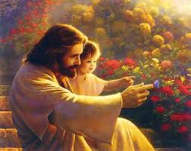
Jesus is still calling us to freedom in the truth
Isn’t this the only true freedom that there is in the world?

Slide 89
Prophecy and order is not being fulfilled by independents
In the light of the previous testimony, perhaps a question is appropriate here: where, in the independent ministries is the representation that the individual members should have through delegates to any conference? How can there be unity if there is no representation? How can the High Priestly prayer of Christ ever be fulfilled by independents?
We know that the church invisible includes all of those who are living up to every ray of light they have had, in whatever church they belong to in the world. Great Controversy tells us that the majority of those who will make up the 144,000 will come out of the fallen churches. This should cause us to consider: “Am I living up to every ray of light that is shining on the church visible?” What then? Notwithstanding, every way, whether in pretence, or in truth, Christ is preached; and I therein do rejoice, yea, and will rejoice.” Phil. 1:18

Slide 90
True Freedom through Christ
A voice from the past
The truth would make us free
Abraham Lincoln once said, “I am not bound to win, but I am bound to be true. I am not bound to succeed, but I am bound to live by the light that I have. I must stand with anybody that stands right,and stand with him while he is right and part with him when he goes wrong.” Let us do the same as we seek unity on the platform of truth with all of those who love truth.
In conclusion: the only true freedom man has ever had is in Christ, Who is the Way, Truth and Life. He came to seek and save the lost by means of the truth. He has empowered His church to share the “purity of the truth” with the world, and this is the only way that man can have power to be uplifted from the pit of sin.

Slide 91
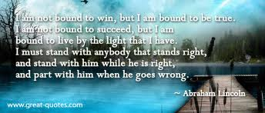
True, moral independence

Slide 92
The Freedom of Marriage, a type of Christ’s relation to the church
Purity of truth is the only thing
that has the power to uplift and save
When man looks for independence in any other way than the purity of the truth he is only deceiving himself. Just as in marriage, there is no true independence until there is a complete yielding of the heart to one’s spouse, also in the bride of Christ, we cannot find true independence until we submit our hearts completely to Him Who is love. He has ordained His church that are keeping His commandments, to the be the arm of His love in a revolted world.
“Love and loyalty to Christ are the spring of all true service. In the heart touched by His love, there is begotten a desire to work for Him. Let this desire be encouraged and rightly guided. Whether in the home, the neighborhood, or the school, the presence of the poor, the afflicted, the ignorant, or the unfortunate should be regarded, not as a misfortune, but as affording precious opportunity for service. {Ed 268.2}

Slide 93
We need practical experience in this
“In this work, as in every other, skill is gained in the work itself. It is by training in the common duties of life and in ministry to the needy and suffering, that efficiency is assured. Without this the best-meant efforts are often useless and even harmful. It is in the water, not on the land, that men learn to swim. {Ed 268.3}
“Another obligation, too often lightly regarded,--one that to the youth awakened to the claims of Christ needs to be made plain,--is the obligation of church relationship. {Ed 268.4}

Slide 94
Connection with Christ, means connection with His true church
“ Very close and sacred is the relation between Christ and His church--He the bridegroom, and the church the bride; He the head, and the church the body. Connection with Christ, then, involves connection with His church. {Ed 268.5}
“The church is organized for service; and in a life of service to Christ, connection with the church is one of the first steps. Loyalty to Christ demands the faithful performance of church duties. This is an important part of one's training; and in a church imbued with the Master's life, it will lead directly to effort for the world without. {Ed 268.6}

Slide 95

Do we have the faith to believe His promises? If so, we will be there.
And God so loves us, that He has already provided everything necessary and right for us to step out and believe His promises.

